Slide 1
KUBERNETES

Slide 2
Introduction of Kubernetes
Kubernetes is a container management system developed on the Google platform.
Kubernetes helps to manage containerized applications in various types of physical, virtual, and cloud environments.
Google Kubernetes is a highly flexible container tool to consistently deliver complex applications running on clusters of hundreds to thousands of individual servers.

Slide 3
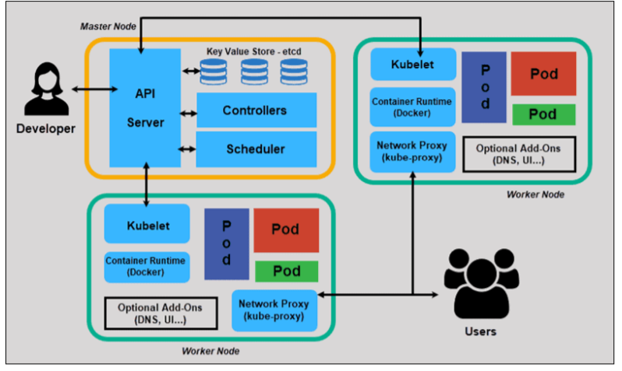
Architecture of Kubernetes

Slide 4
Architecture of Kubernetes
In Kubernetes, various sub-components can be grouped into two main components. The main components are:
Master nodes and
Worker nodes

Slide 5
Master Node
The management of a cluster is the responsibility of the master node as it is the first point of contact for almost all administrative tasks for the cluster
Master node comprises different components such as Controller-manager, ETCD, Scheduler, and API Server.
API Server: It is the first point of contact for the entirety of the REST commands, which are used to manage and manipulate the cluster.
Scheduler: The scheduler, as its name suggests, is responsible for scheduling tasks to the worker nodes. It also keeps the resource utilization data for each of the slave nodes.
ETCD: It is majorly employed for shared configuration, as well as for service discovery. It is basically a distributed key-value store.
Controller-manager: It is a daemon that is responsible for regulating the cluster in Kubernetes, and it also manages various other control loops that are non-terminating.

Slide 6
Worker / Slave Nodes
Worker or slave nodes consist of all the needed services that are required to manage networking among containers.
The services communicate with the master node and allocate resources to scheduled containers.
Worker nodes have the following components:
Docker container: Docker must be initialized and run on each worker node in a cluster. Docker containers run on each worker node, and they also run the pods that are configured.
Kubelet: The job of kubelet is to get the configuration of pods from the API server. It is also used to ensure that the mentioned containers are ready and running.
Kube-proxy: Kube-proxy behaves like a network proxy and act as a load balancer for a service on any single worker node for pods running on the node by implementing east/west load-balancing using NAT in iptables. The kube-proxy handles network communications inside or outside the cluster
Label: Used to identify pods
Pods: A pod can be thought of as one or more containers, which can logically run on nodes together.

Slide 7
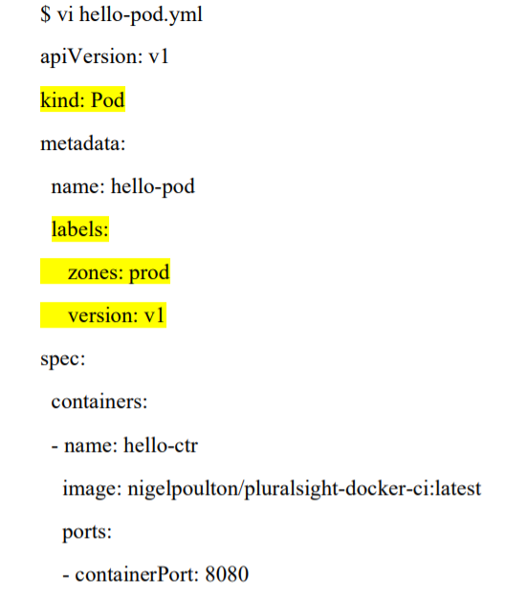
HOW TO CREATE A POD IN A CLUSTER

Slide 8
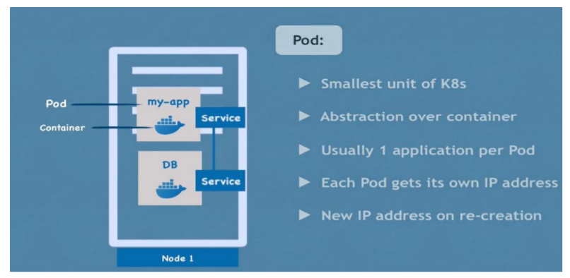

Slide 9
Types of Kubernetes Health check
Types of Kubernetes Health check:
Readiness=when Pod is ready to accept the traffic. (health)
Liveness=when to Restart the pod (ping)

Slide 10
Replication Controller
RC is a controller that is part of the Master Node’s Controller Manager.
It makes sure the specified number of replicas for a Pod is running at any given point in time.
Available in master

Slide 11
ReplicaSet
A ReplicaSet (rs) is the next-generation ReplicationController.
Replica Sets support both equality- and set-based Selectors, whereas Replication Controllers only support equality-based Selectors.
Available in deployment

